Slide 1

Programming IV

Slide 2
Statistical Programming Assignment
Instructions
Download Analysis 3 Zip Folder
Unzip Folder
Open Analysis 3 Rmd File
Knit to HTML
Read Introduction
Three Part Assignment
Each Part Self Contained
Most Answers Require Copy-and- Paste
Where You See COMPLETE You Should Write/Place Code
Leave Code as is When You See #DO NOT CHANGE

Slide 3
Part 1 Discussion
Process of Programming
Create Practice Example
Check Code Works
Apply Code to Real Data
Check Code Works
Create a Function of the Process
Goals
Create a Function that Creates a Factor Variable of Abbreviated Weekdays (Easy)
Create a Function that Creates a Plot (Difficult)
Start Working (15 min)

Slide 4
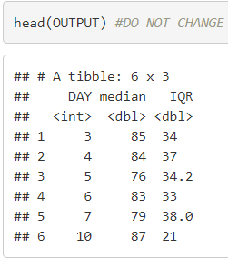
Part 2 Discussion
Focus on Traffic Volume (DATA2) and Specific Location (“L103”)
Look at Table
Goal: Reconstruct this Table

Slide 5
Part 2 Discussion
Steps:
Given the Day in April, Create Function that Outputs the Associated Row
Use the Function in a Loop to Construct the Table
Two Loops
Initiate with NULL
Initiate with Empty Tibble
Look at Lecture on Loops
Q3 is Tricky
Start Working (15 min)

Slide 6
Part 3 Discussion
Functions That Apply Functions Across Dimensions Of R Object
Doesn’t Require a Loop
Tibbles are Matrices
Apply Functions to Rows
Apply Functions to Columns (Think Summarize)
Apply() Function to Matrix
To Rows
To Columns
Start Working (Rest of Class)
apply(Matrix, 1, Function)
apply(Matrix, 2, Function)

Slide 7
Closing
Disperse and Make Reasonable Decisions

